Slide 1
Optimising Aircraft Carry-On Luggage Storage Using Digital Twin Technology
A Data-Driven Simulation Approach to Improving Aircraft Boarding Efficiency
Speaker: Rizwan Khan

Slide 2
Project Aim and Context
Aim: To improve carry-on luggage storage efficiency in aircraft cabins by developing a realistic Digital Twin simulation of passenger boarding behaviours.
Why It Matters: Boarding delays and luggage congestion lead to significant operational costs, frustrate passengers, and affect airline schedules. Research shows that storage-related boarding delays alone can cost airlines thousands of pounds per day per route.

Slide 3
How I Solved It
My solution:
Created high-fidelity 3D cabin models.
Simulated real passenger behaviours.
Designed and tested multiple storage and boarding scenarios.
Analysed data to identify optimal solutions.

Slide 4
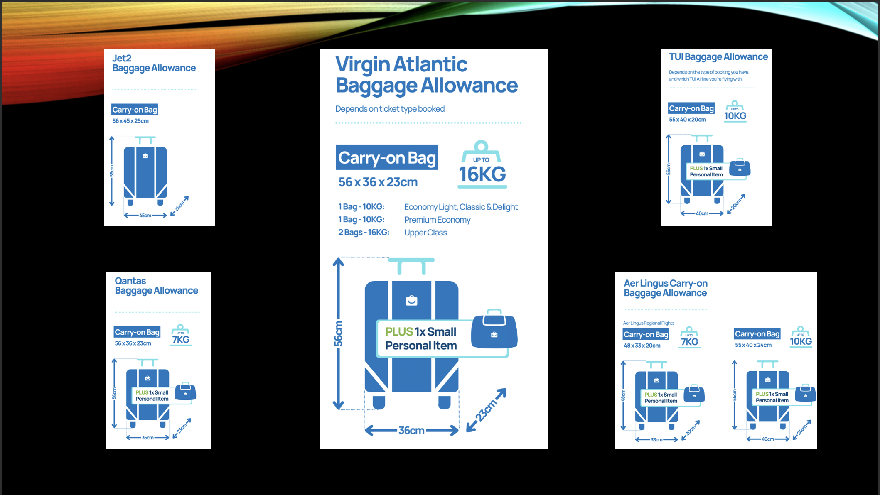
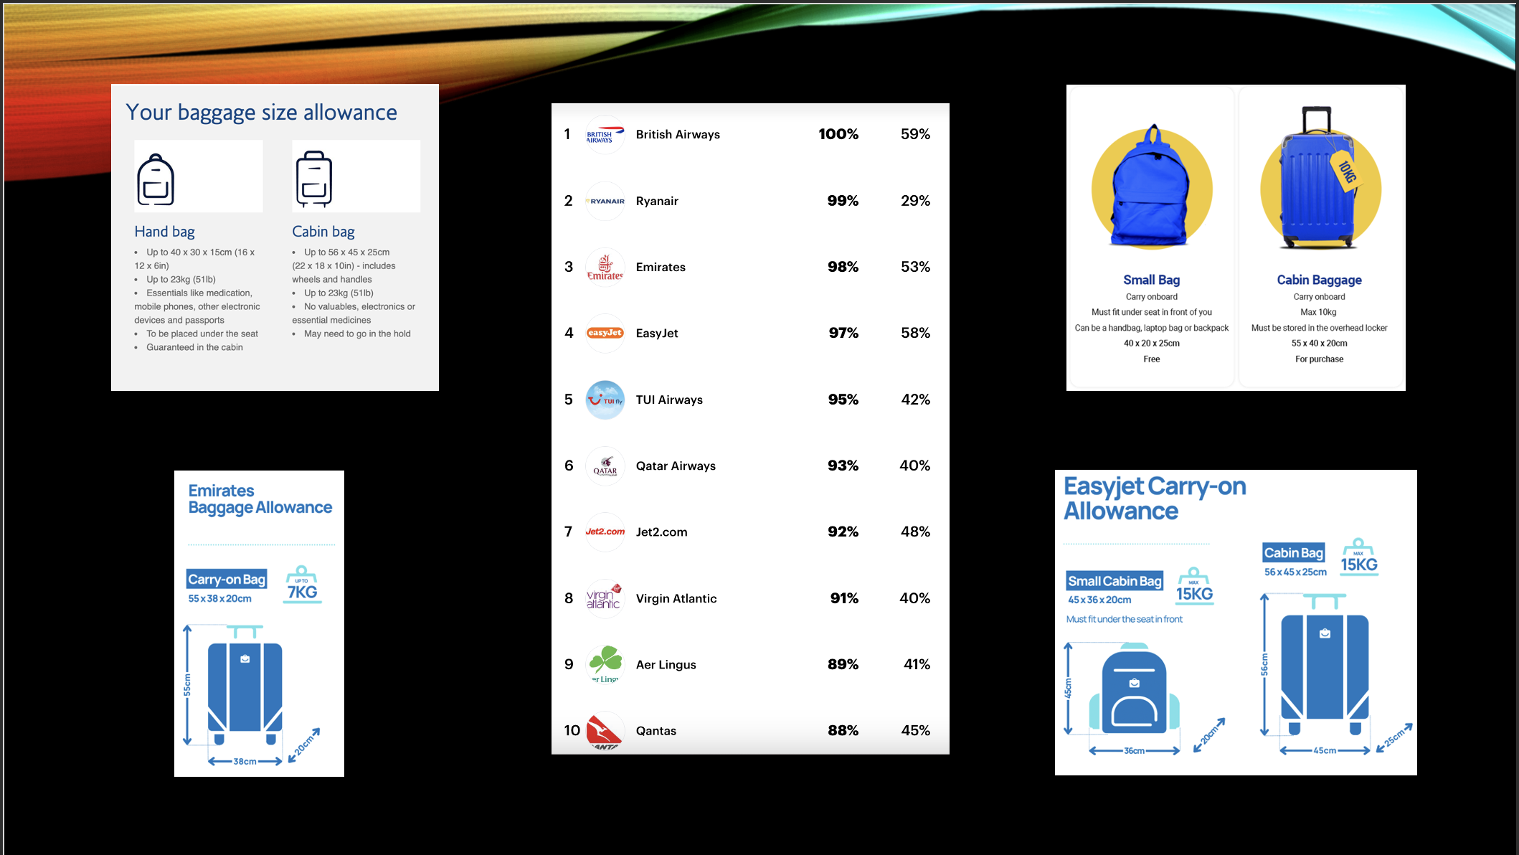
Research and Foundation
Airlines' storage guidelines (sourced from MyBaggage).
Passenger behaviour trends (YouGov popularity rankings).
Simulation best practices (Digital Twin methodology).

Slide 5
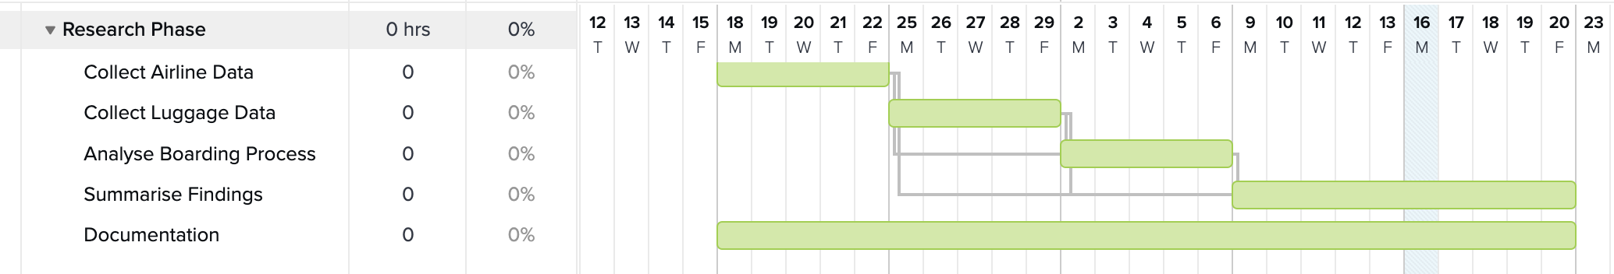
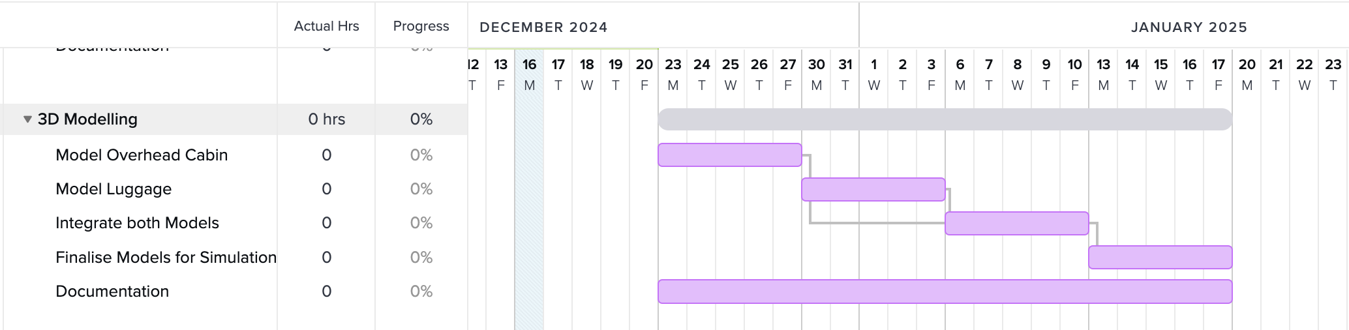
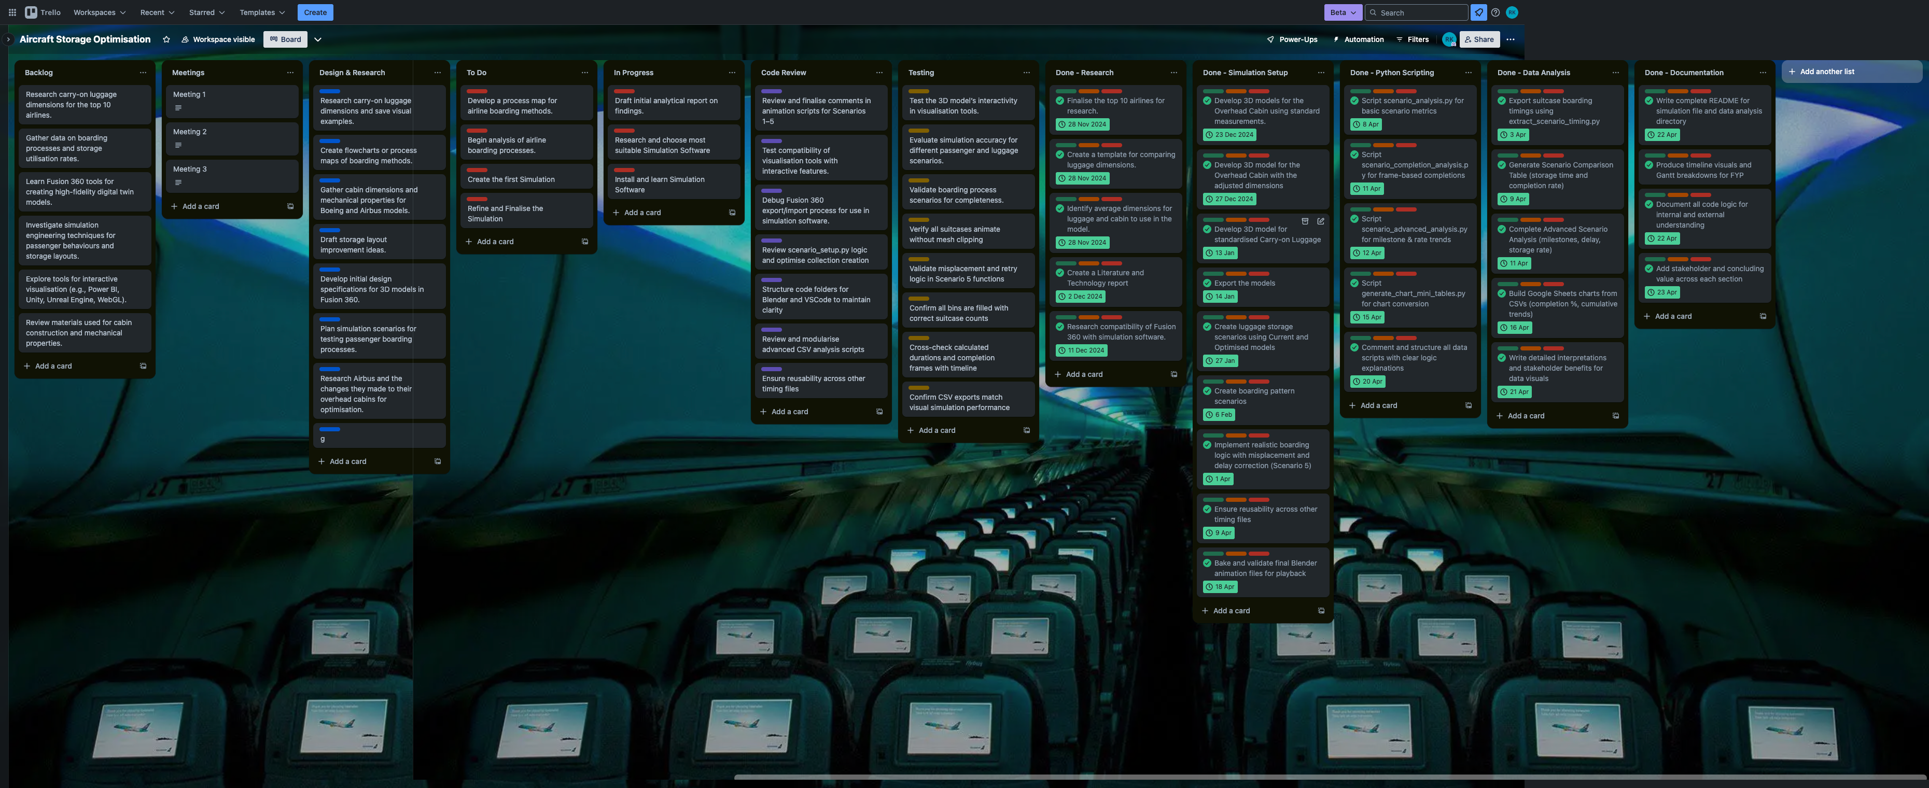
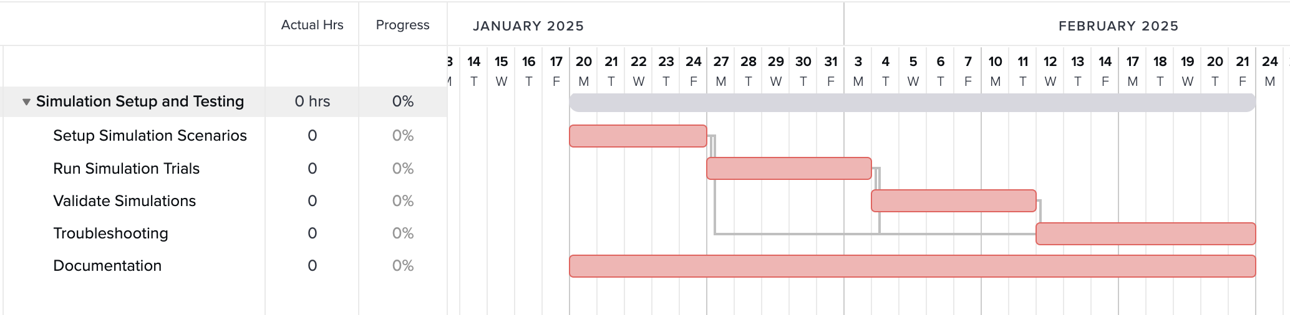
Project Management Approach
Managing a Complex Project
Trello board used for weekly sprint planning.
Gantt charts tracked major milestones.
Risks mitigated through modular development and version control.

Slide 6
Why These Scenarios?
Scenario Selection Rationale
Designed to represent a realistic progression from ideal to chaotic boarding environments.
Tests both structural improvements (bin design) and behavioural unpredictability (passenger mistakes).
Allows stakeholders — airlines, aircraft designers, and airport operators — to visually and measurably assess:
- How well layout upgrade improve capacity and speed. - How human behaviour impacts operational performance. - Whether improved designs are resilient under real-world conditions.
Provides evidence-based insights for purchasing decisions, cabin redesigns, and boarding policy changes.

Slide 7
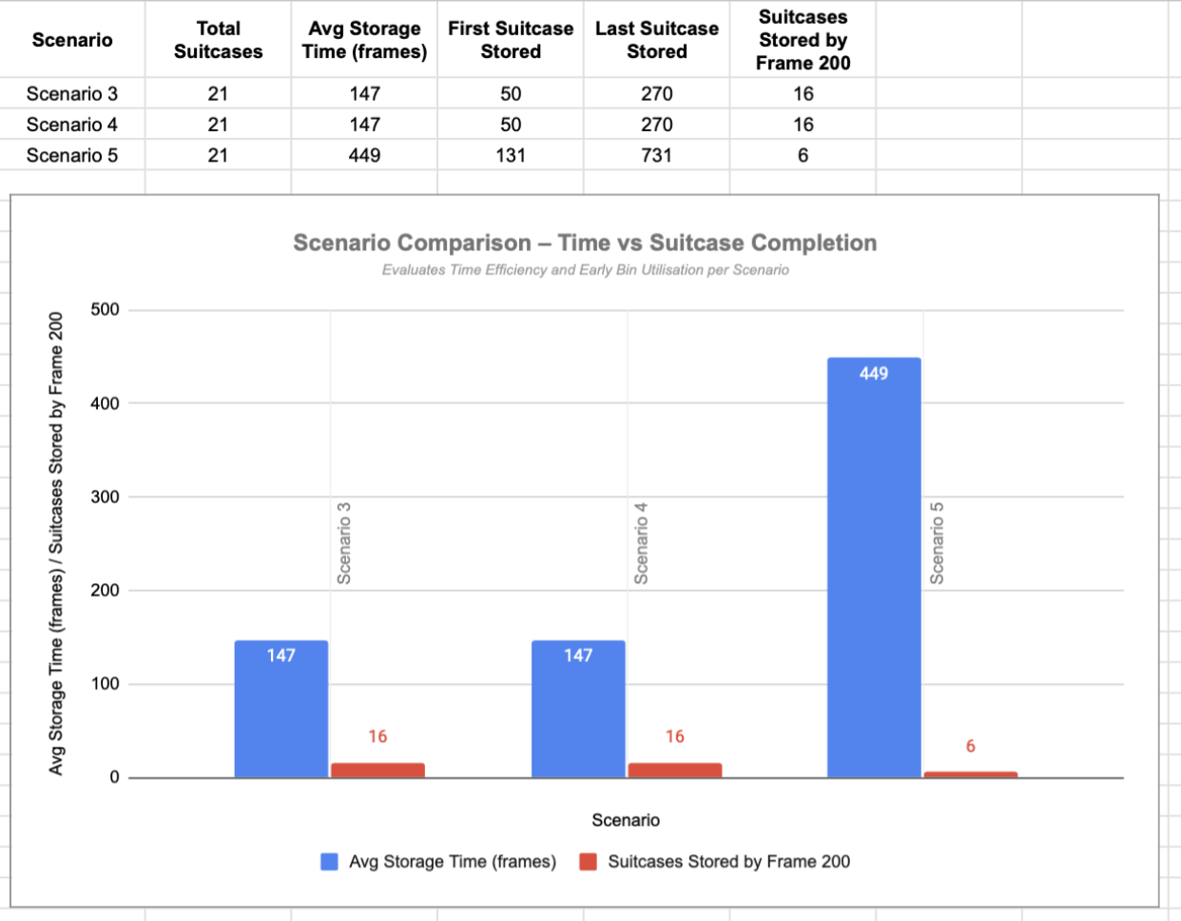
Measuring Boarding Time and Storage Efficiency
Recorded total suitcase boarding times for each scenario (efficiency comparison)
Measured storage success rates based on bin utilisation
Chose these metrics because delays and storage failures are key airline operational issues

Slide 8
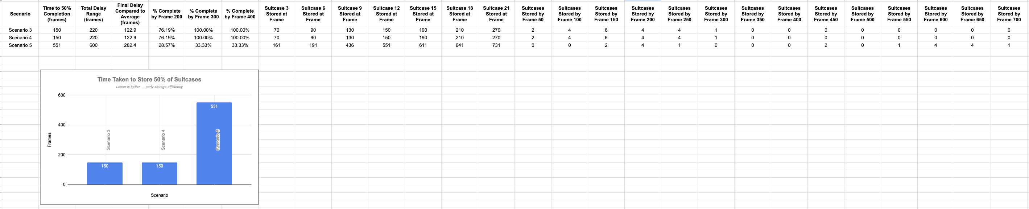
Performance Gains: Faster Boarding and Higher Capacity
OptimisedCabin increased storage capacity by 25–30% (vs CurrentCabin)
Boarding times reduced by up to 18%, even under randomised conditions
Metrics chosen because they solve critical airline pain points: space constraints and boarding delays

Slide 9
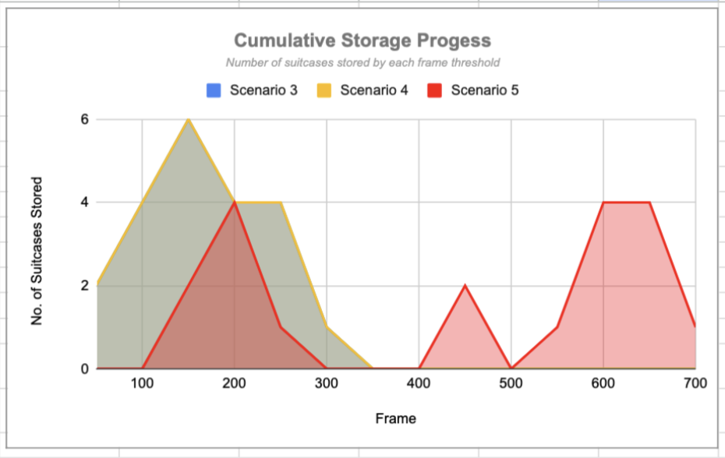
Real-World Benefits for Airlines and Aircraft Designers
Faster boarding = lower turnaround costs and improved schedule reliability
Higher bin capacity = fewer last-minute baggage removals
Data-backed results create a low-risk upgrade path for stakeholders

Slide 10
Final Recommendation & Industry Opportunities
Digital Twin simulations proved that optimised bin designs reduce delays, even under boarding chaos.
Layout upgrades offer measurable operational gains and customer experience benefits.
Clear next steps:
- Prototype testing of optimised cabin bins in real aircraft. - Integration of simulation into airline layout planning. - Collaboration with design teams on implementation models.
Stakeholder outcome: A validated pathway to faster boarding, lower costs, and improved service.

Slide 11
References
MyBaggage.com – Airline carry-on baggage sizes and weight policies
YouGov.co.uk – Airline popularity data and passenger behaviour insights
Airline-specific visuals sourced from Emirates, EasyJet, Virgin Atlantic, Jet2, Qantas, Aer Lingus, TUI via MyBaggage.com (All sources accessed and cross-checked as of April 2025)

